Slide 1
Academy Forum 2: How are students using technology? Dr Jim Woolley Learning and Teaching Enhancement Unit lteu@aber.ac.uk

Slide 2
Session structure
Discussion based:
Current technologies
Digital Insights Survey
Discussion on the findings from Digital Insights
Planning for the future

Slide 3
Discussion: Challenges
You’ll be sent into 3 breakout groups:
What challenges do you think students currently face in using technology?
Please nominate a spokesperson to feed back.

Slide 4
Discussion: Advantages
You’ll be split into 2 groups:
Reflect on your current experience.
What currently works well in terms of the technology?
Please nominate a spokesperson to feedback

Slide 5
Digital experience insights survey: findings from learner/student survey conducted 2021-2022 at Aberystwyth University​ Prepared by Kate Wright, Lauren Harvey, and Joseph Wiggins

Slide 6
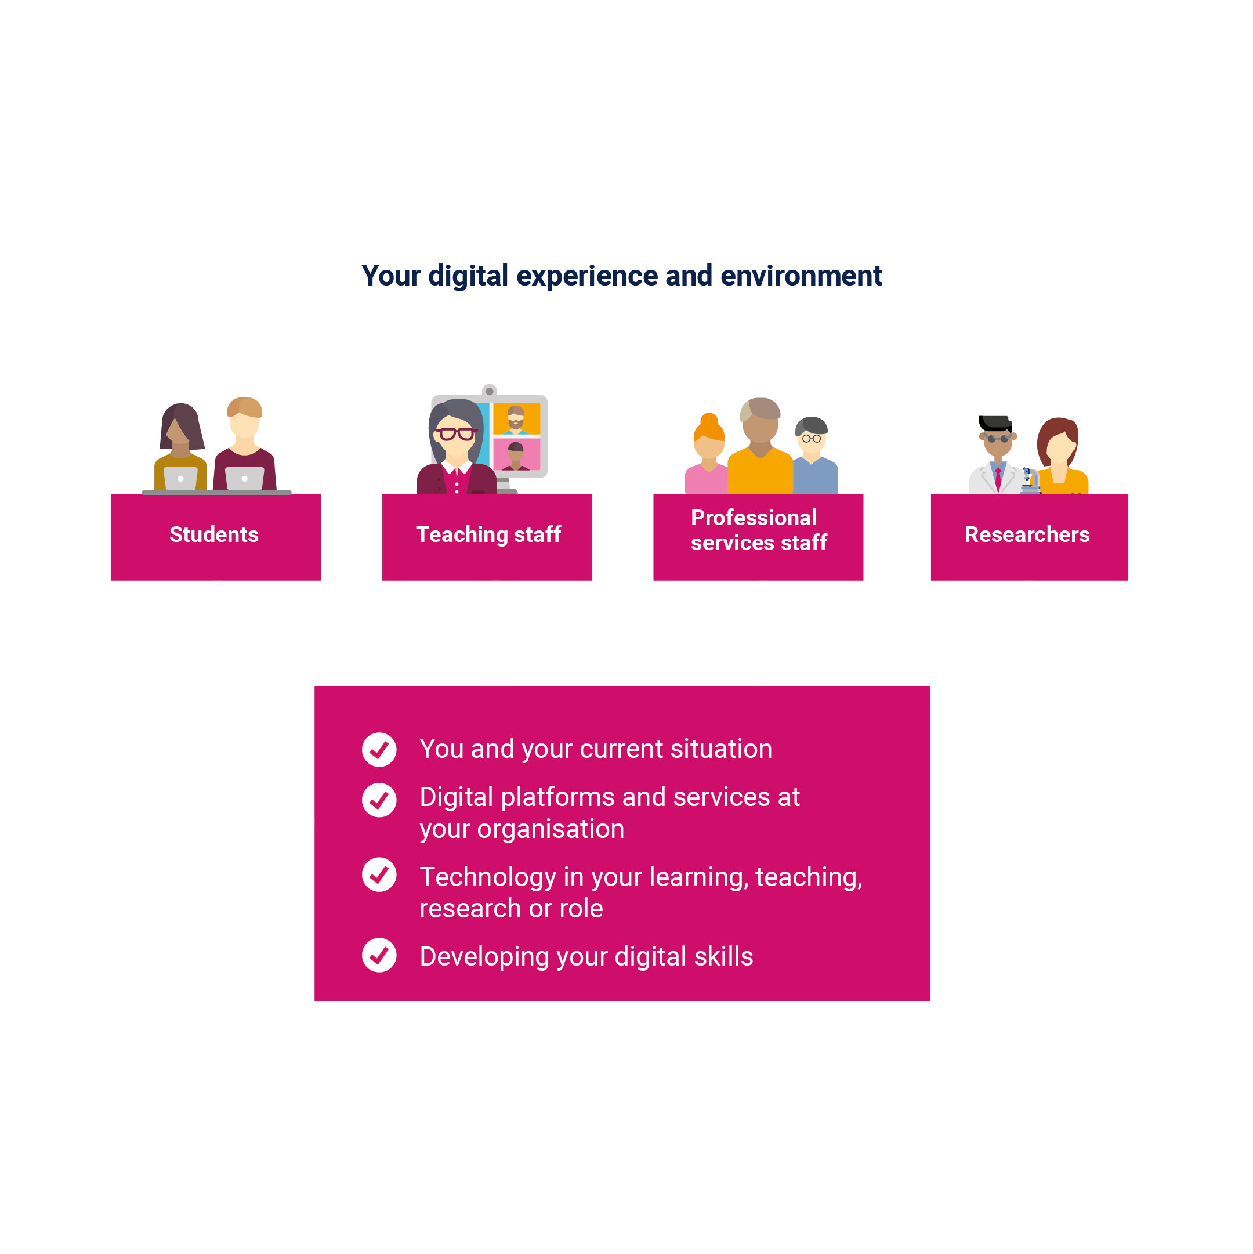
What is the learner/student digital experience insights survey?
Asks learners/students across further education (FE) and higher education (HE) about their experiences of using technology at their college or university and on their course
Run by Jisc
Separate surveys for FE and HE
For 2020/21 there were nearly 63,000 responses from UK FE learners and HE students
This presentation summarises some key findings from data collected from our learners/students
Notes:
In terms of the responses to the survey:
Over 600 students took part at AU this year.

Slide 7
Summary of key metrics
Technology at your organisation
80.72% agreed they were supported to use their own devices (Q12a HE)
74.40% agreed we supported them to access online platforms/services off site (Q12b HE)
82.56% rated the quality of the online learning environment as good or above (Q14 HE)
Technology in your learning
44.33% agreed they had engaging and motivating online learning materials (Q21a HE)
72.36% agreed that learning online was convenient (Q22a HE)
80.39% rated the quality of the online learning on their course as good or above (Q25 HE)
Developing your digital skills
21.79% agreed we provided them with reward and recognition for their digital skills (Q27d HE)
71.86% rated the support we offered them to learn effectively online as good or above (Q30 HE)
Notes:
So these are some of the key metrics as highlighted by JISC and how AU scored on them. You can see from this a pretty high set of results – and it’s really encouraging to see both the quality of our learning environment and the quality of online learning achieving scores in 80% and above range.
I’m not actually going to talk about the digital skills metrics today – we’ve got a short amount of time, and we’ll be hearing a presentation tomorrow about digital skills which may address some of the issues around reward and recognition for digital skills.
Going to concentrate on the information that we think will be useful to our teaching staff.

Slide 8
Benchmarking with other UK organisations

Slide 9
Benchmark comparisons
The digital experience insights surveys national dataset allows us to compare our results with anonymised overall results from other UK organisations that ran the learner/student insights survey (see table below)..
We have compared the eight key metrics shown earlier in this presentation on slide 4.
Question | Our data | UK data
Supported to use own devices (Q12a HE) | 62.56% | 57.62%
Support access to online platforms/services off site (HE) | 74.40% | 69.26%
Quality of the online learning environment (Q14 HE) | 82.56% | 76.93%
Engaging and motivating online learning materials (Q21a HE) | 44.33% | 42.84%
Online learning is convenient (Q22a HE) | 72.36% | 68.03%
Quality of online learning on course (Q25 HE) | 80.39% | 74.32%
Provided reward/recognition for digital skills (Q27d HE) | 21.79% | 24.04%
Supported to learn effectively online (Q30 HE) | 71.86% | 66.08%
Notes:
You can see in this slide that in the majority of the metrics we’ve just looked at AU is scoring higher than the UK. And again our support to learn online effectlively scores pretty high.
If we take a look at this data, we can see that the majority of metrics are ahead of UK data but, there are some still areas to develop.
We’re being the UK average on reward and recognition for digital skills so that is something that we would like to develop.
Some really positive comments around the quality of online learning.
Even though we are above the average, some work clearly needs to be done on engaging students with online material.

Slide 10
Findings by theme
Notes:
We’ll turn now to look at some of the findings by theme

Slide 11
Theme one (T1)
You and your technology

Slide 12
T1: Devices used regularly for learning
(Q9). Learners/students were asked, which of these devices they regularly used for learning (they could tick all that applied).
Notes:
This is a really useful guide to how our students are accessing our materials. The trend towards students using smartphones has been growing over the years but this year smartphone is the second largest group of devices students use. I think one thing that we can do as a result of this is to have a look at your own materials on a phone. It will give you an idea of what things look like to your students when they are trying to do their work.

Slide 13
Theme two (T2)
Technology at your organisation

Slide 14
T2: Digital platforms and services at your organisation
Live video classes: 85.9% eg Zoom, MS Teams, Google Meet
Virtual learning environment: 93.4% eg Moodle, Blackboard, Canvas
Collaborative applications: 28.7% eg Google Docs, virtual boards, wikis
Online assessment or testing platform: 63.5%
Student dashboard for tracking progress: 35%
Notes:
So this helps us to understand how students feel about the platforms and services at AU. The survey gave students a list of what we meant by platforms and services and asked which they used
Live video classes eg Zoom, MS Teams, Google Meet
Virtual learning environment eg Moodle, Blackboard, Canvas
Collaborative applications eg Google Docs, virtual boards, wikis
Online assessment or testing platform
Student dashboard for tracking progress

Slide 15
T2: Digital platforms and services at your organisation
(Q12a). 62.56% agreed we supported them to use their own devices
(Q12b). 74.40 % agreed we supported them to access online platforms and services off site
(Q12c). 66.67% agreed we communicated effectively online, eg messaging, notifications
(Q12d). 36.14% agreed we gave them the chance to be involved in decisions about learning platforms
Notes:
So this helps us to understand how students feel about the platforms and services at AU.

Slide 16
T2: Digital tool or app really useful for learning
(Q13). Learners/students were asked to give an example of a digital tool or app they found really useful for learning.
Common Digital Tool/applications included:
43.4% of learners/students that commented mentioned “Blackboard”
9.4% of learners/students that commented mentioned “Microsoft Teams”
Expanded explanations cited reasons for choosing Blackboard such as:
- Central to the learning experience
Accessibility from many different types of devices
Well organised and fit for use*
*Answers also specified that the usefulness could be compromised by ineffective course organisation
Notes:
Also, seeing students using tools that help them avoid distractions – things such forest and study bunny
Quizzes / flashcards– students using tools to quiz themselves
Grammarly for checking spelling and grammar
Primo
Dictation / speech software and also text to speech
Around 40% students made comments that included Blackboard and we can see that students did comment on

Slide 17
T2: Overall quality of the online learning environment
(Q14). Learners/students were asked to provide an overall rating for the quality of the online learning environment. 82.6% rated us as good or above.

Slide 18
T2: Prefer us to invest in
(Q15 HE). Learners/students were asked what they would prefer us to invest in?

Slide 19
Theme three (T3)
Technology in your learning

Slide 20
T3: Difficulties when learning online
(Q18 HE). Learners/students were asked if any of these made it difficult for them to learn online (they could tick all that applied).
Notes:
Poor wifi has been a theme through all of the digital insights surveys. Will be interesting to see the results as students spend more time on campus.

Slide 21
T3: Learning activities they have carried out
(Q20 HE) Learners/students were asked, in the last two weeks, which learning activities they had done.
Notes:
Can see the types of learning activities that students have carried out in the last two weeks (remember that we held the survey from the end of March to the end of April).
We can see that recorded lectures or online lectures was the most common activity.
Good to see that online tests are increasing in use – with around 1 in 5 of our students taking part in those. This combined with the use of quizzes mentioned in early slides, shows an interest among students in testing, which we know from cognitive science is a really valuable approach to learning.

Slide 22
T3: Online learning materials
(Q21). Learners/students were asked how much they agreed with four statements about our online learning materials.
Notes:
Good to see that the work that staff is doing to produce online materials is paying off. The results in available in good time are particularly good to see as this has been an issue reported by students in the past. And great work being done on accessibility
If you are interested in finding out more about creating online active learning for student engagement we have lots of materials that we produced in the pandemic.

Slide 23
T3: Learning online
(Q22). Learners/students were asked how much they agreed with four statements about learning online.
Notes:
This information gives us an idea of what students think about online learning – and this does seem to fit with more general opinions on online learning. It’s convenient for students, helps them to contribute and make progress, but it’s less useful in making them feel part of a community.
And I think that this helps us think about how we make use of online learning – can we prioritise our face-to-face opportunities to help build our communities, and make sue of online for other tasks and activities.

Slide 24
T3: Positive aspects of online learning
(Q23 HE). Learners/students were asked, what aspect of learning online, if any, had been most positive for them.
This was a free text question, which we analysed for themes.
Common themes included:
19.3% of learners/students that commented mentioned accessibility
16.9% of learners/students that commented mentioned being able to pace work themselves and/or time management
9.2% of learners/students that commented mentioned lecture recordings
1.4% of learners/students that commented mentioned there were no positives
Notes:
Fitting in around other commitments
Managing mental / physical health conditions
Comfort in their own surroundings – including feeling more comfortable and confident asking questions

Slide 25
T3: Negative aspects of online learning
(Q24). Learners/students were asked, what aspect of learning online, if any, had been most negative for them.
This was a free text question, which we analysed for themes.
Common themes included:
20.6% of learners/students that commented mentioned lack and/or difficulty of motivation and distractions
9.8% of learners/students that commented mentioned lack of contact with staff
2.6% of learners/students that commented mentioned Blackboard as negative
“Online learning in itself is taxing. Online learning doesn’t have the same feeling.
It is something which isn't marked with attendance, isn't easily promoted and
pushed. which make it difficult for students like myself either with low
energy or executive dysfunctions to find the will power that structured
lessons provide”
Notes:
This helps gives us some information about what our students value – and this may give us some pointers towards the kinds of support needed by students, or that we can prioritise when we are meeting students face-to-face. Its clear that our students value contact with staff and other students,
Some of the themes that come through with Blackboard are things are can be addressed through organisation and course design, and some of them can be addressed as we think about how Blackboard will looking when we’ve upgraded to Ultra. However, the number of comments about Blackboard are dropping year on year – so please keep doing what you have been doing, using the RMP etc.
Navigation around content, labelling of materials, finding grades

Slide 26
T3: Overall quality of online learning on their course
(Q25). Learners/students were asked to provide an overall rating of the quality of online learning on their course. 80.4% rated us as good or above

Slide 27
Resources
Find out more
LTEU Blog
JISC Student digital experience insights survey 2021/22: higher education findings (pdf)

Slide 28
Break

Slide 29
Discussion: Digital Insights Data
Whole group discussion:
What surprised you about the data and summary?

Slide 30
Discussion: Developing plans
You’ll be split into pairs:
What digital and technological changes would you like to see developed at the University?

Slide 31
Discussion: Changes
Off the back of the discussion today,
What will you change in your teaching practice?

Slide 32
Thank you
Next Academy Forum:
17 November, 10:00-11:30:
In person, E3
Wellbeing in the Curriculum

